Slide 1
Designing an EMA/AA Study
Maddy Frumkin, PhD
Assistant Professor
Center for Technology and Behavioral Health
Departments of Biomedical Data Science and Psychiatry
Geisel School of Medicine at Dartmouth
Notes:
Device - do older adults have smartphones?

Slide 2
Overview
When should I use EMA/AA?
What items should I use?
How often should I ping people, and for how long?
How should I compensate people?
What technology/software should I use?

Slide 3
When should I use EMA/AA?
You have a between-persons question that would benefit from greater measurement precision.
Do more active people have better cognitive performance on average?
→ Self-report of physical activity tends to be inaccurate when compared to objective measurements
→ Cognitive performance varies across settings, times of day, etc.

Slide 4
When should I use EMA/AA?
You have a within-persons question.
Do people have better cognitive performance on days when they are more physically active?
→ Potential mechanism/intervention target

Slide 5
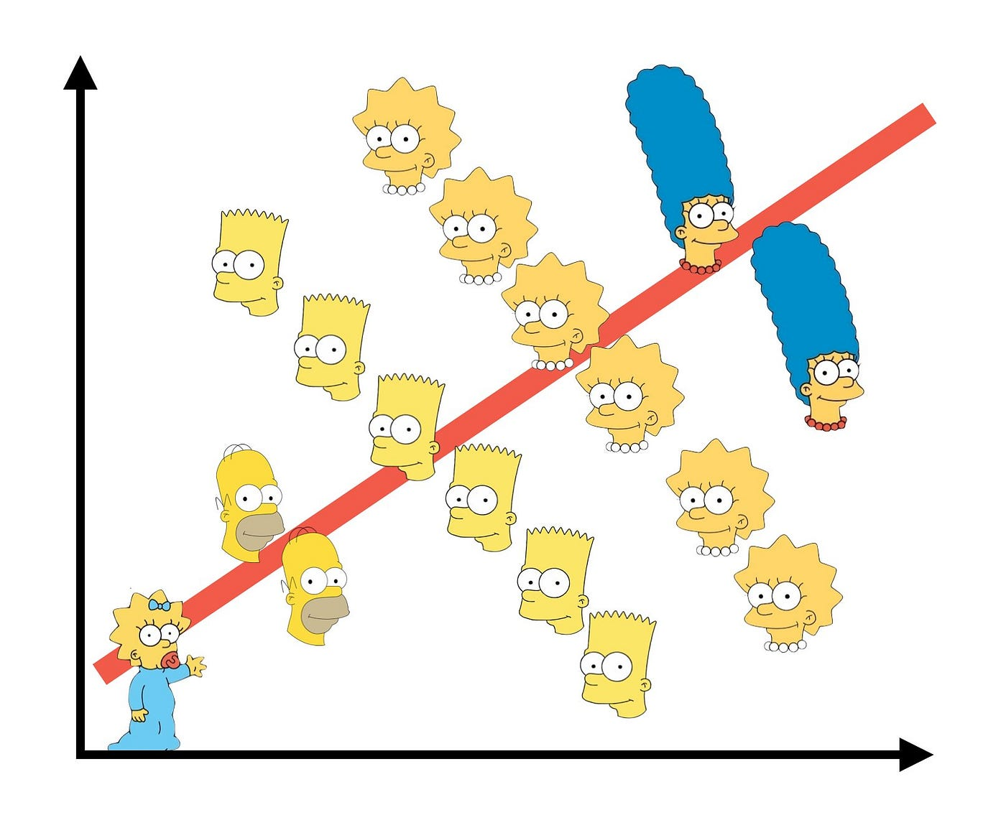
When should I use EMA/AA?
You have a within-persons question.
Typing Accuracy
Typing Speed

Slide 6
When should I use EMA/AA?
You have a question about individual differences in within-person dynamics.
Is activity more strongly associated with subsequent cognitive performance among older individuals? Individuals with greater cognitive impairment?

Slide 7
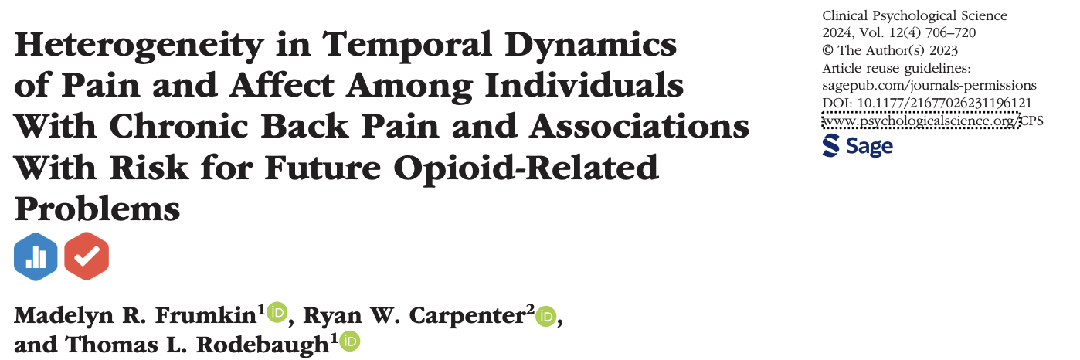
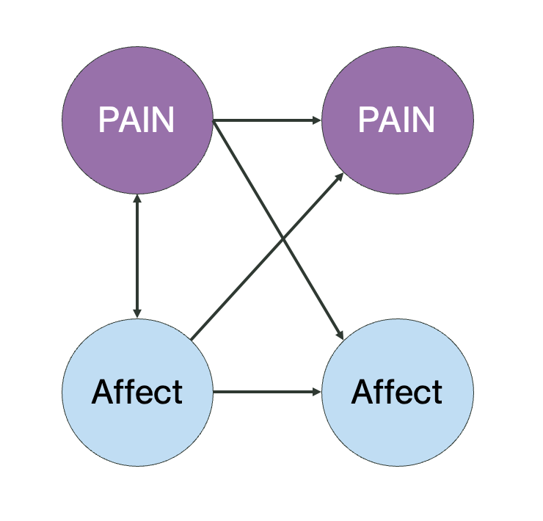

Slide 8
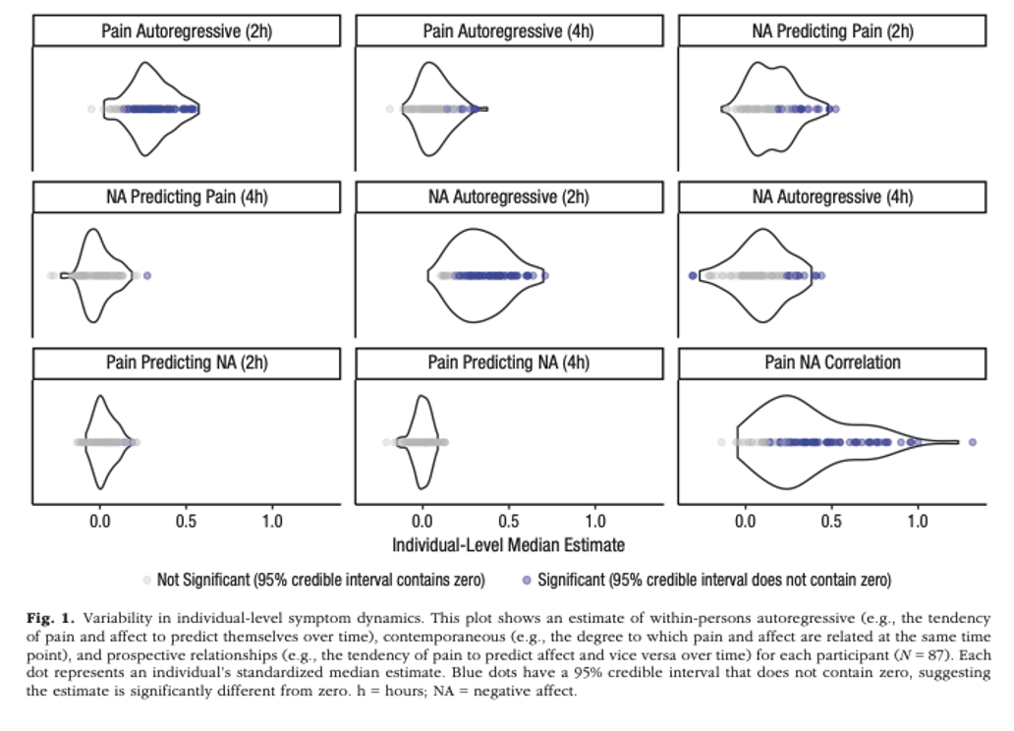

Slide 9
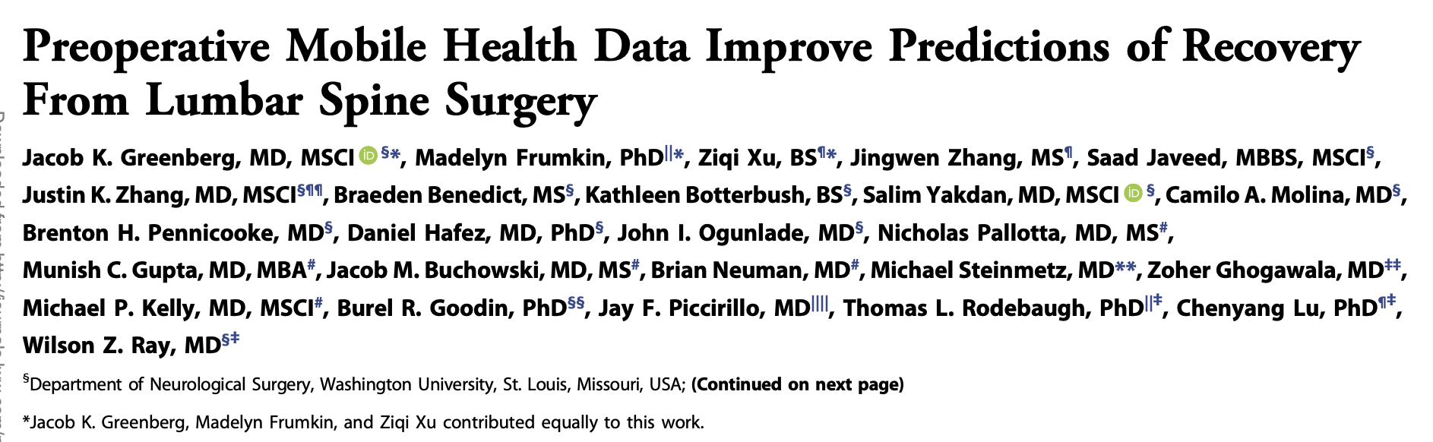
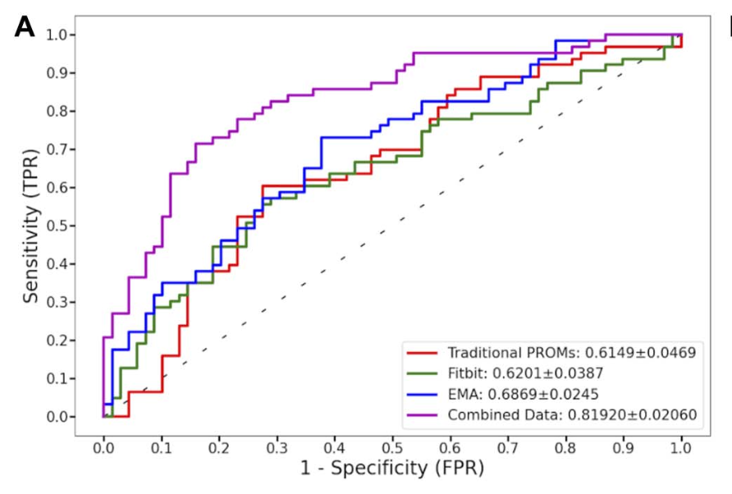
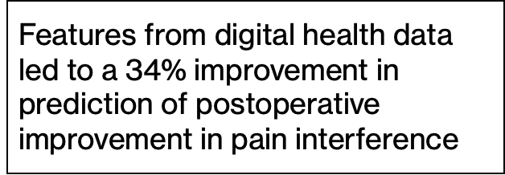

Slide 10
When should I use EMA/AA?
You have a question about the timing and/or direction of effects.*
Is activity associated with same-day cognitive performance? Next-day? Next week?
*Depending on the hypothesized timing of effects, you may not need full EMA/AA

Slide 11
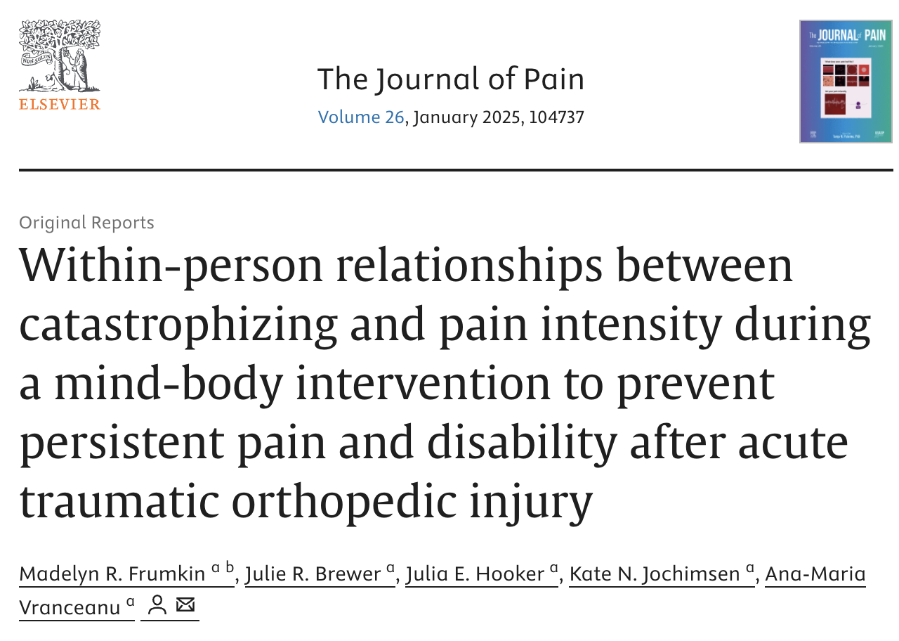
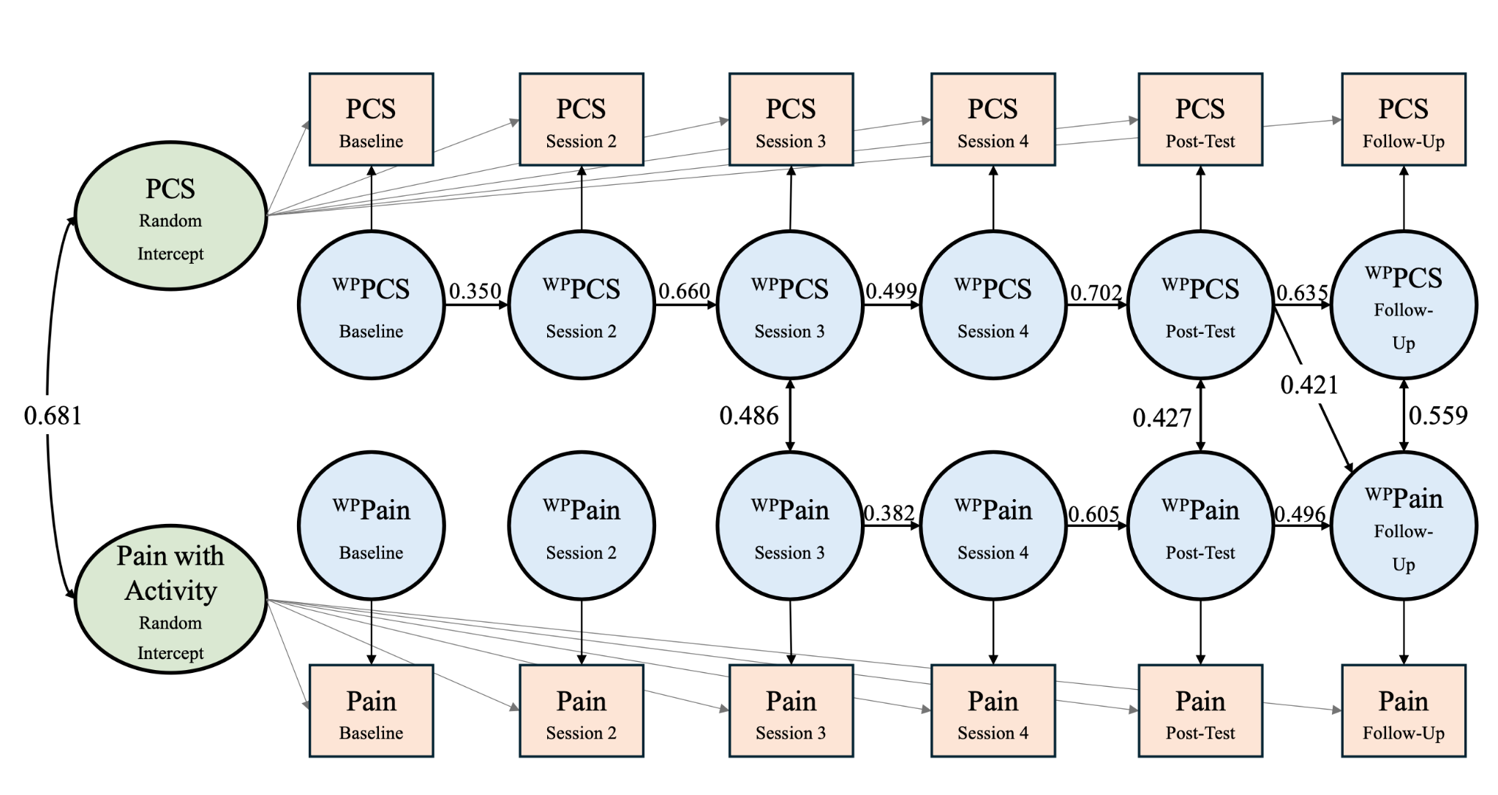

Slide 12
With a partner…
Give an overview of your research question.
Is it a between-persons question? Within-persons? Both?
What is the timescale of within-persons effects (e.g., minutes, hours, days, months, years)?
Sketch out your hypothesized findings.

Slide 13
When should I use EMA/AA?
You have a within-persons question, a between-persons question that would benefit from greater precision, or a between-persons question about within-person dynamics
Tip: Identify a research question that is testable, and interesting regardless of the outcome
Tip: Consider pre-registration (e.g., https://osf.io/t58xp)

Slide 14
Overview
When should I use EMA/AA?
What items should I use?
How often should I ping people, and for how long?
How should I compensate people?
What technology/software should I use?

Slide 15
What EMA items should I use?
Start with a list of constructs you want to measure, e.g. …
Anxiety
Depressed mood
Difficulty concentrating
Subjective sleep quality

Slide 16
What EMA items should I use?
Can these constructs be measured with a single item, or are they multi-faceted?
Anxiety → anxious, worried
Depressed mood → low mood, hopeless, worthless
Difficulty concentrating
Subjective sleep quality

Slide 17
What EMA items should I use?
Do you expect items to vary across the day? Only once per day? Are any of your constructs rare or infrequent?
Right now….
Since the last prompt…
Today…

Slide 18
What EMA items should I use?
Are you interested in frequency? Intensity?
Right now…. How anxious are you?
Since the last prompt… How many cigarettes have you smoked?
Today…I feel rested.
Tip: Be cautious about flipping scales

Slide 19
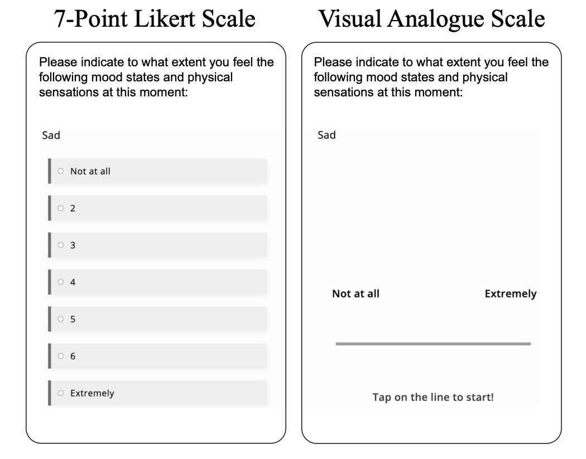
What EMA items should I use?
What types of responses do you want?

Slide 20
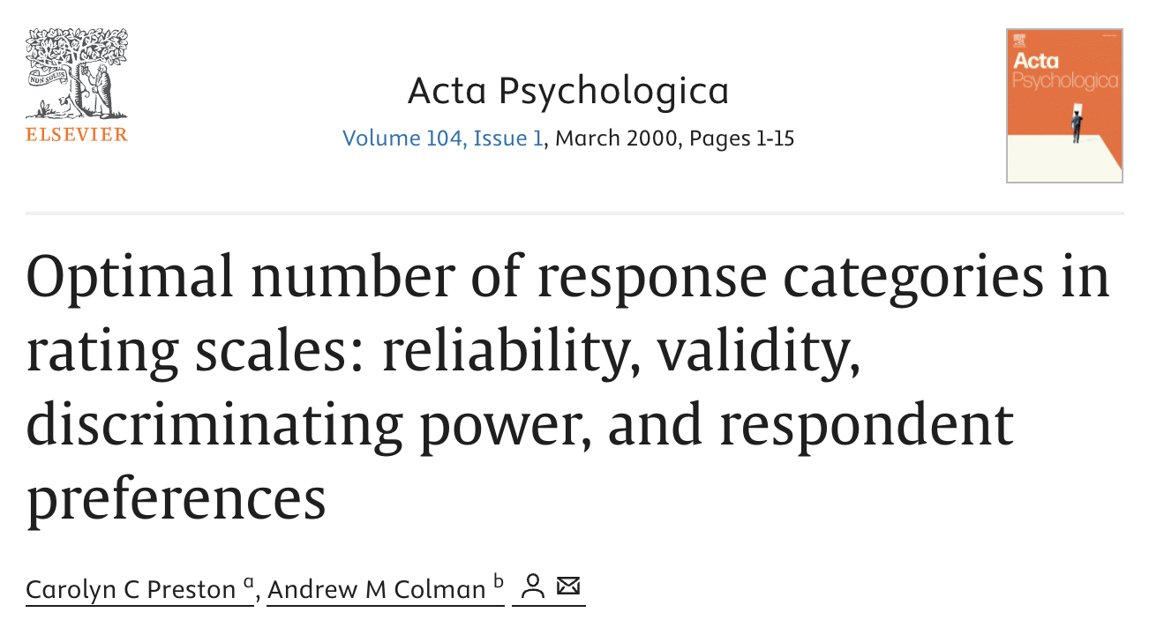
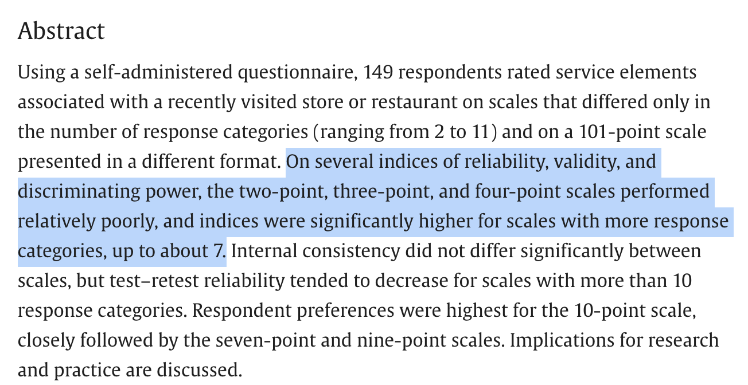

Slide 21
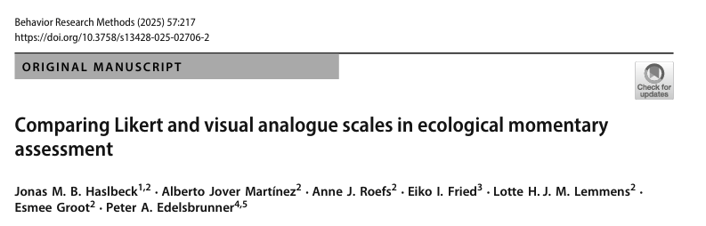
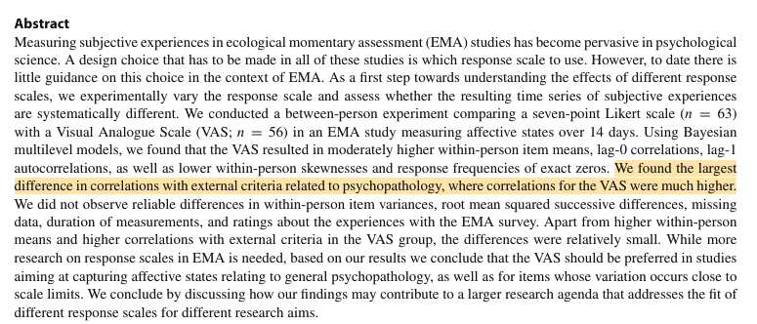
Notes:
Keep a consistent response scale

Slide 22
With a partner…
Draft your EMA items, e.g…
Right now, I feel anxious.
0 (not at all) —————— 100 (worst possible)

Slide 23
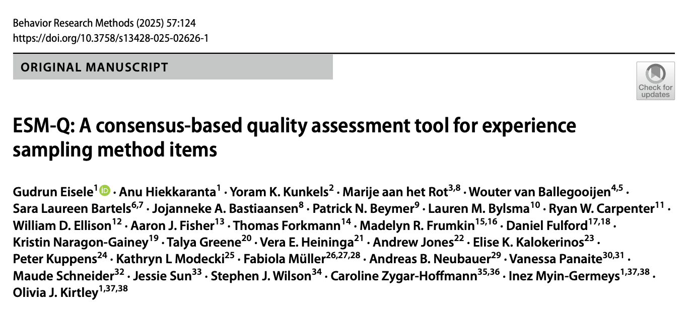
https://osf.io/jqg78

Slide 24
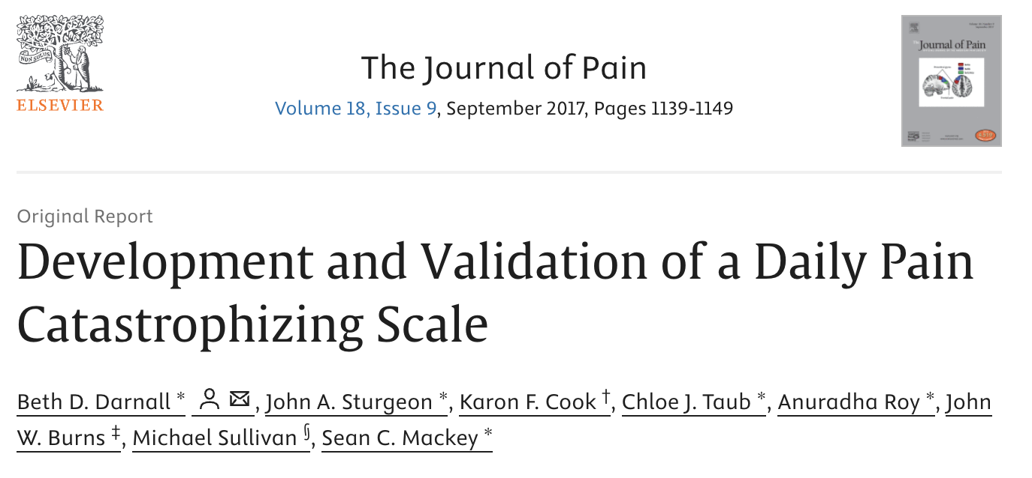
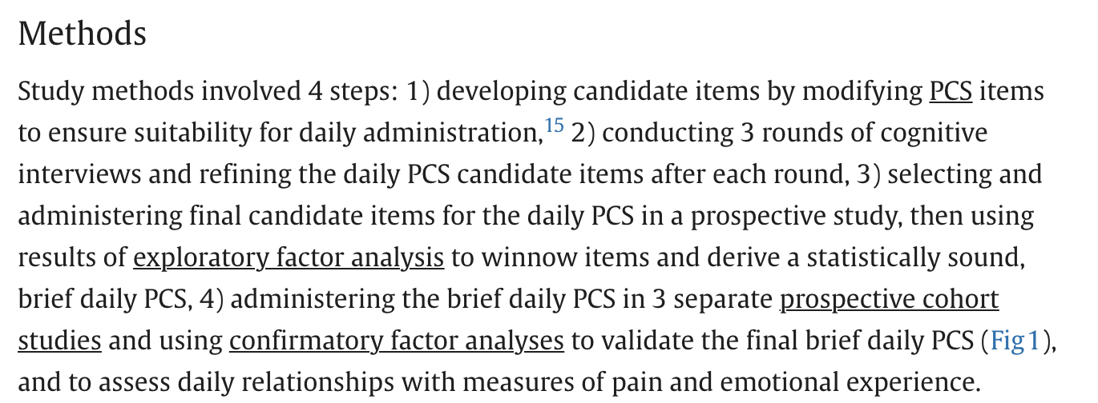

Slide 25
What EMA items should I use?
Cover your key constructs in as few items as possible
Carefully consider whether EMA is right for each construct

Slide 26
What EMA items should I use?
Cover your key constructs in as few items as possible
Where possible, use items that have been shown to have good construct validity (e.g., concordance with related constructs) and reliability

Slide 27
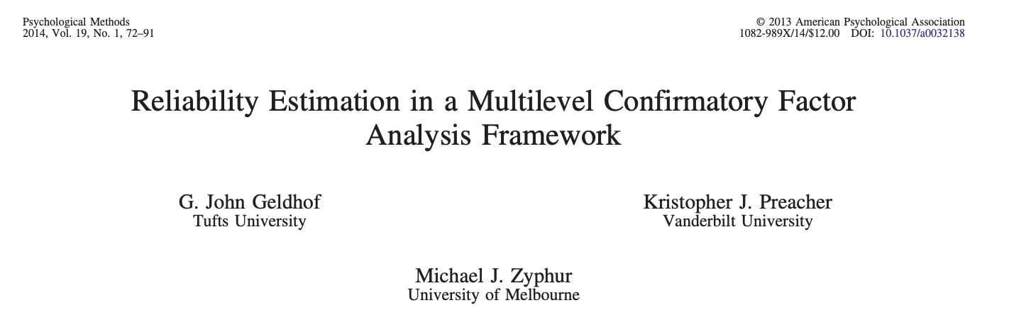
What EMA items should I use?
Cover your key constructs in as few items as possible
Where possible, use items that have been shown to have good construct validity (e.g., concordance with related constructs) and reliability
Quick note: Cronbach’s alpha assumes observations are independent, but they’re not!

Slide 28
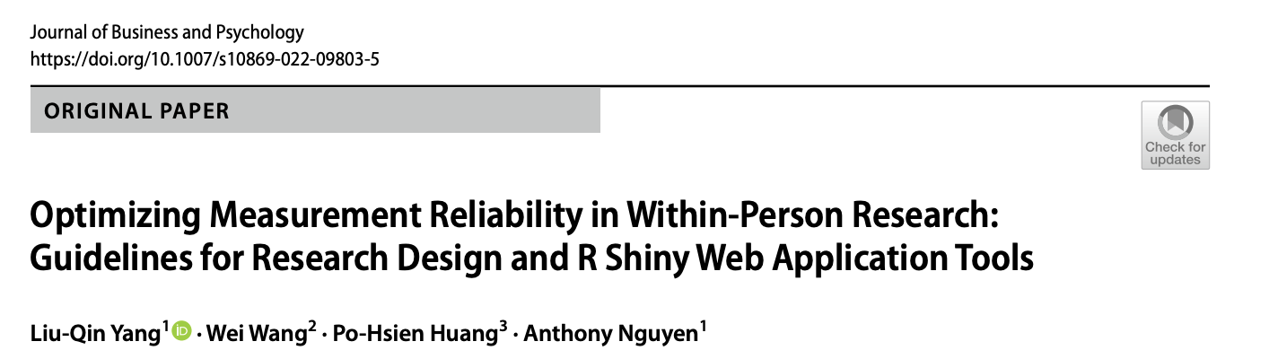
What EMA items should I use?
Cover your key constructs in as few items as possible
Where possible, use items that have been shown to have good construct validity (e.g., concordance with related constructs) and reliability
Quick note: Cronbach’s alpha assumes observations are independent, but they’re not!

Slide 29
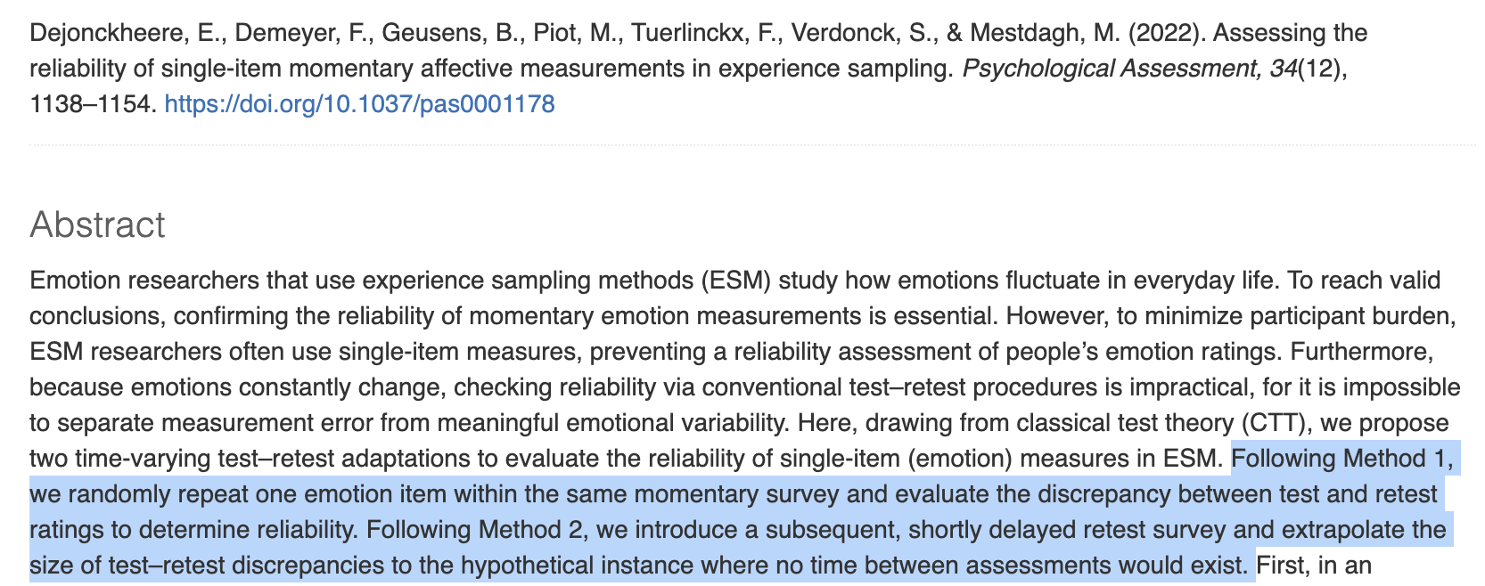
What EMA items should I use?
Cover your key constructs in as few items as possible
Where possible, use items that have been shown to have good construct validity (e.g., concordance with related constructs) and reliability
Quick note: Cronbach’s alpha assumes observations are independent, but they’re not!

Slide 30
What EMA items should I use?
Cover your key constructs in as few items as possible
Where possible, use items that have been shown to have good construct validity (e.g., concordance with related constructs) and reliability
Quick note: Cronbach’s alpha assumes observations are independent, but they’re not!
Aim for consistent phrasing, avoid double-barreled items (e.g., agitation or retardation), and be wary of flipping the response scale (higher = worse vs. higher = better)

Slide 31
Overview
When should I use EMA/AA?
What items should I use?
How often should I ping people, and for how long?
How should I compensate people?
What technology/software should I use?

Slide 32
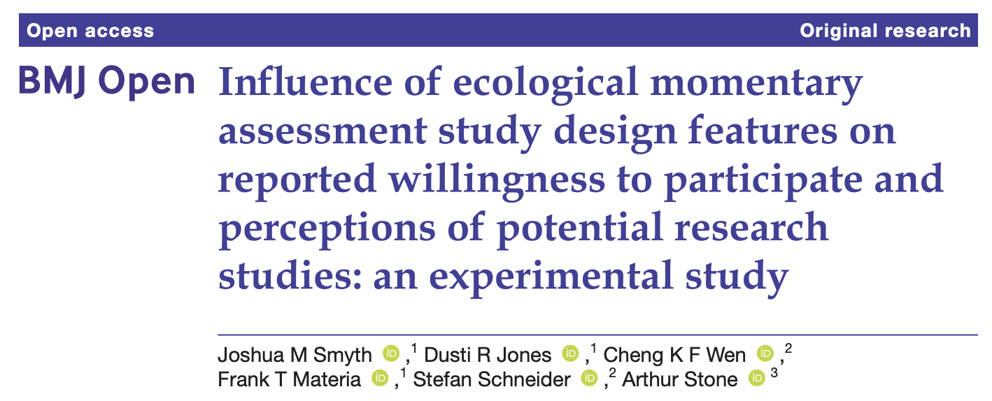
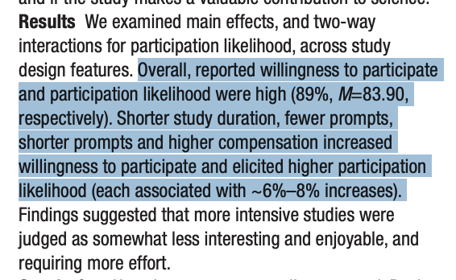

Slide 33
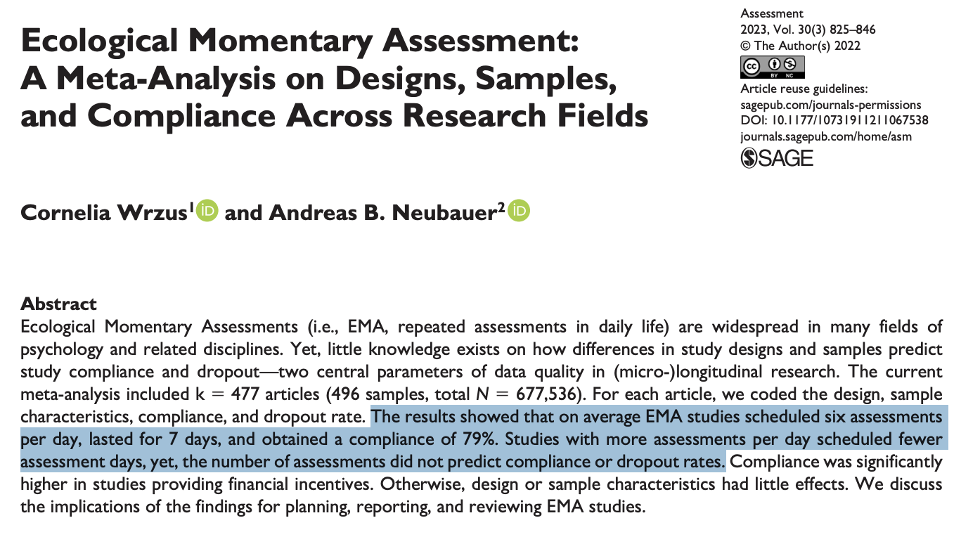

Slide 34
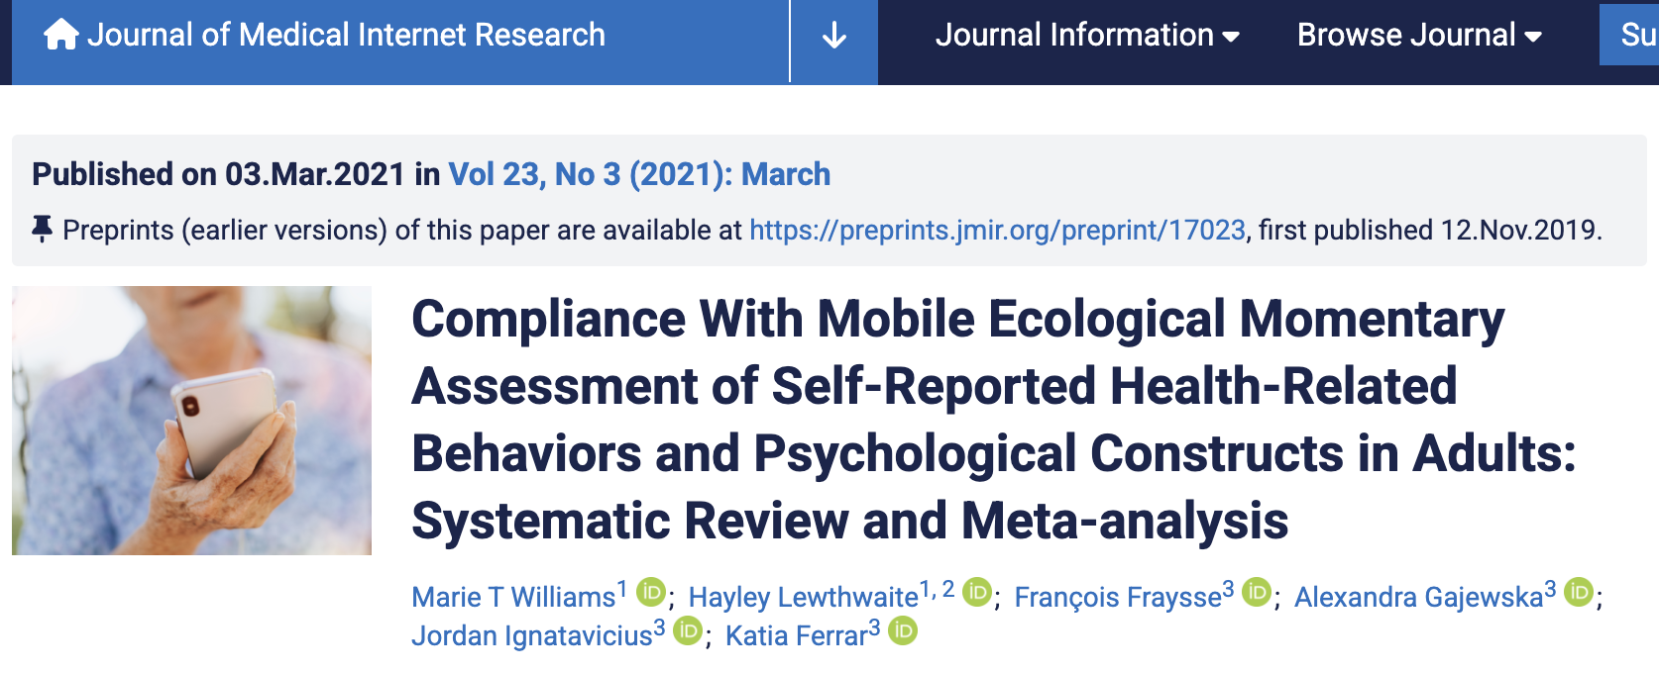
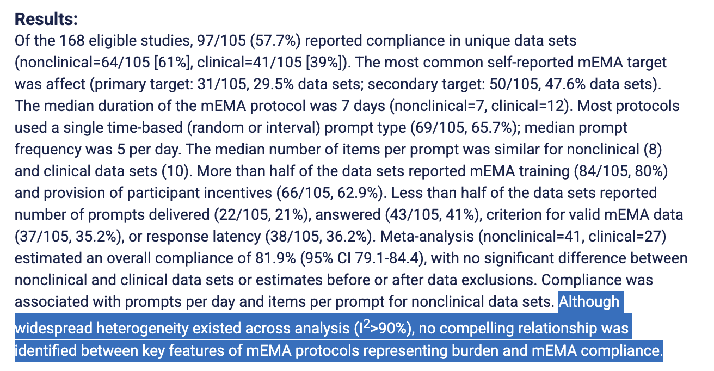

Slide 35
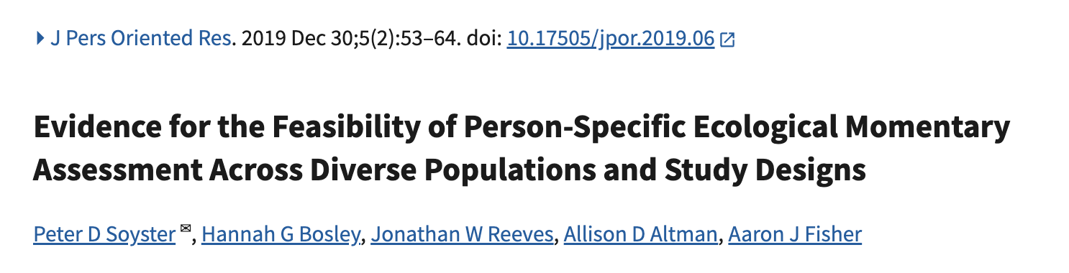
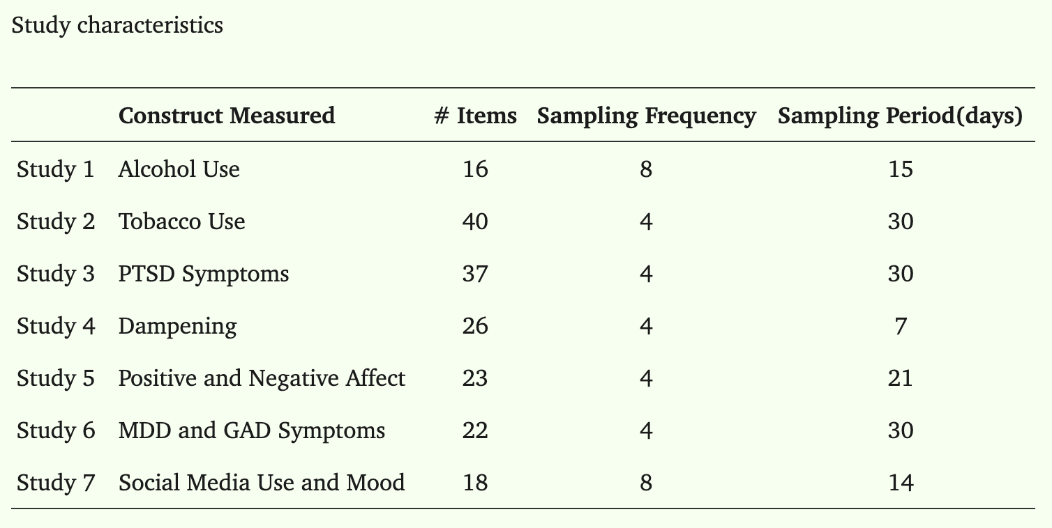
Avg compliance = 82%; Unrelated to study characteristics
Notes:
(2) on average, participants completed 82.21% (SD = 16.34%) of all EMA surveys; and (3) compliance with EMA surveys was not significantly related to participant demographics, psychological diagnosis, personality characteristics, or most study characteristics (e.g., number of surveys per day).

Slide 36
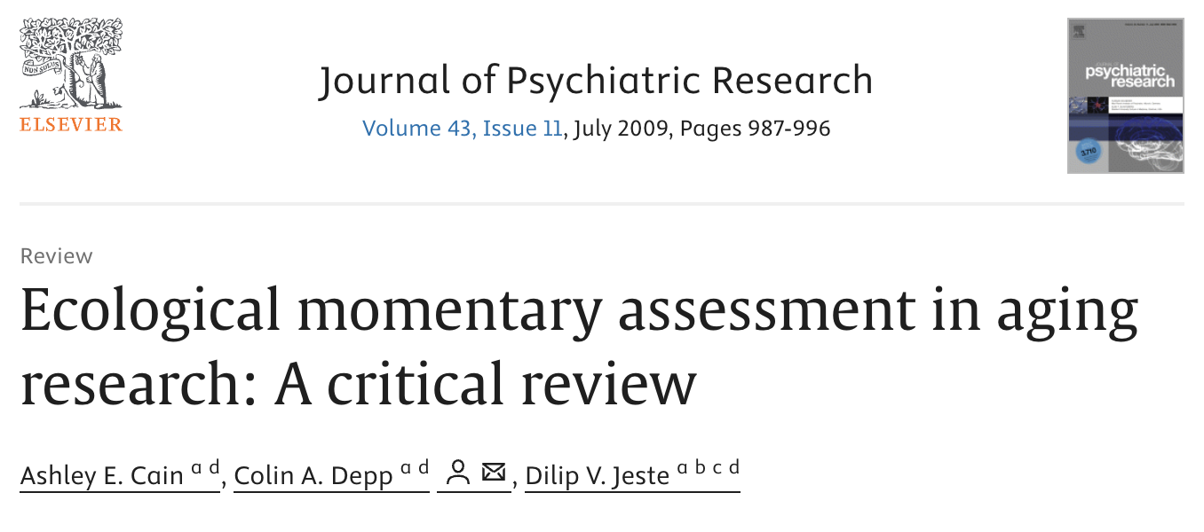
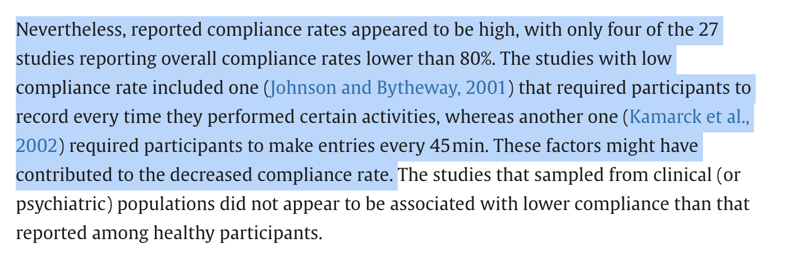

Slide 37
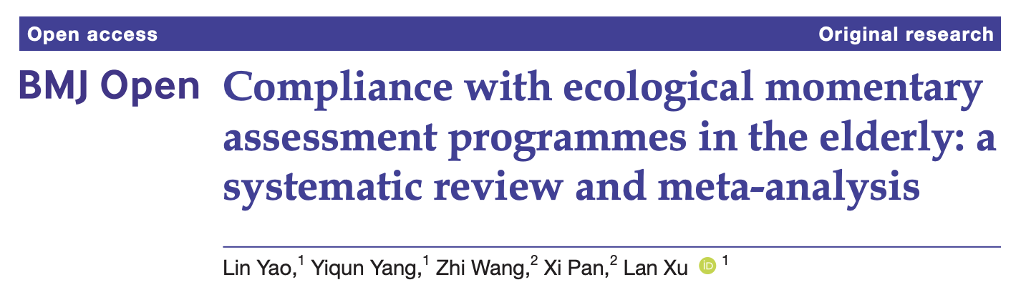
Higher compliance associated with:
Assessment periods ≤7 days (not statistically significant)
More assessments per day: “highest compliance was observed for assessments ≥6 times/day (88.80%; 95%CI: 81.34% to 93.46%), followed by 4–5 times/day (86.53%; 95%CI: 64.57% to 95.77%) and 2–3 times/day (82.64%; 95%CI: 53.99% to 95.07%)”
Notes:
age ≥60 years old → A total of 20 studies with 2047 participants were included in the systematic review and metaanalysis. Meta-analysis showed that the combined compliance rate was 86.41%

Slide 38
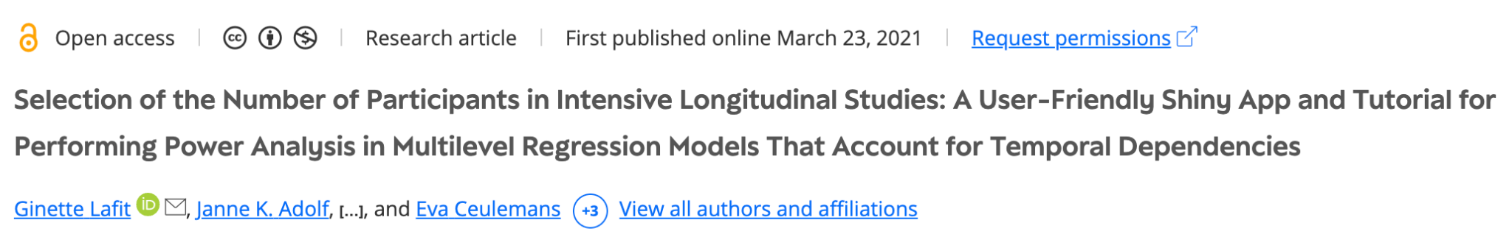
How often should I ping people, and for how long?
What data do you need to answer your research question?
Fixed prompts (e.g., 3x per day at 9am, 2pm, and 7pm)
Stratified random (e.g., 3x per day, randomly within each window)
Event-contingent (e.g., ask participants to report when they drink alcohol)
Daily diary
How much data do you need?

Slide 39
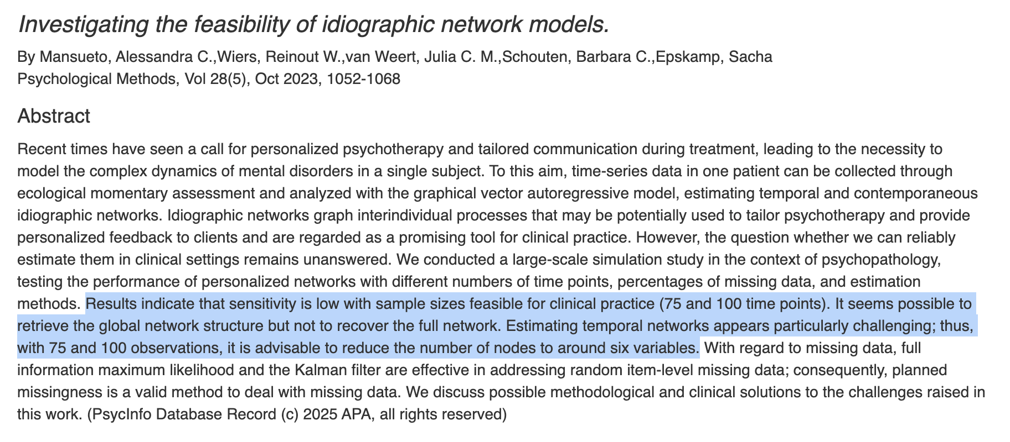
How often should I ping people, and for how long?
How much data do you need?

Slide 40
Overview
When should I use EMA/AA?
What items should I use?
How often should I ping people, and for how long?
How should I compensate people?
What technology/software should I use?

Slide 41
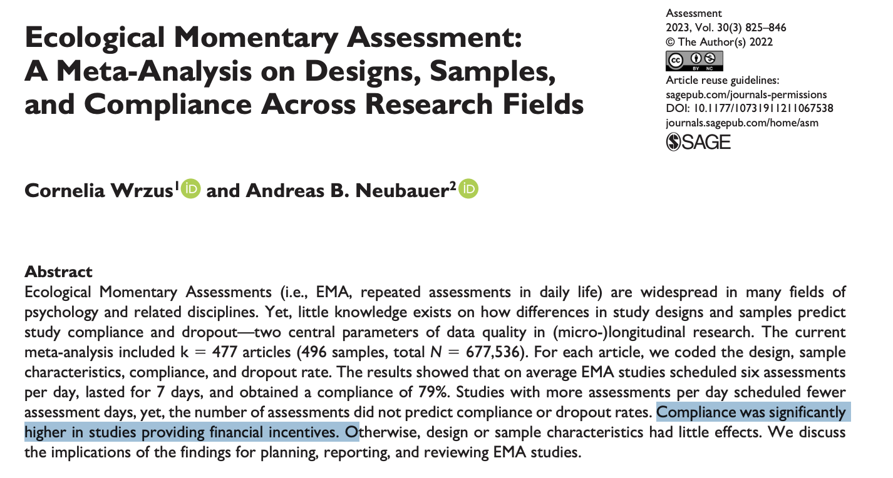
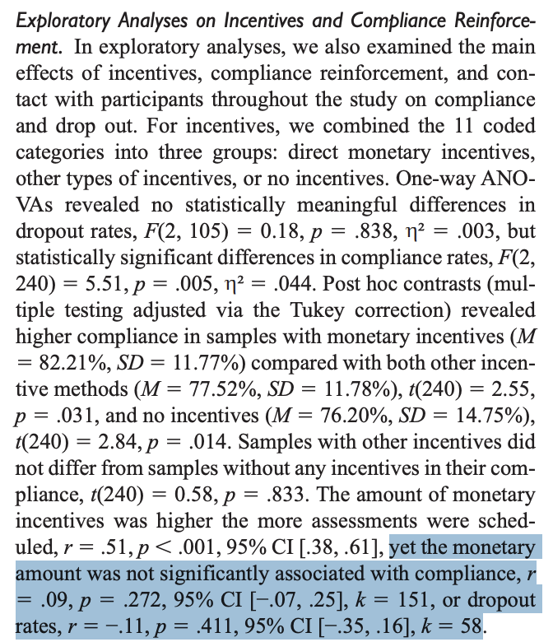

Slide 42
How should I compensate people?
It may not matter much, but here are somethings to consider…
What’s your budget?
Do you have the staff support to pay people during the study, or only at the end?
How important is ecological validity?

Slide 43
Overview
When should I use EMA/AA?
What items should I use?
How often should I ping people, and for how long?
How should I compensate people?
What technology/software should I use?

Slide 44

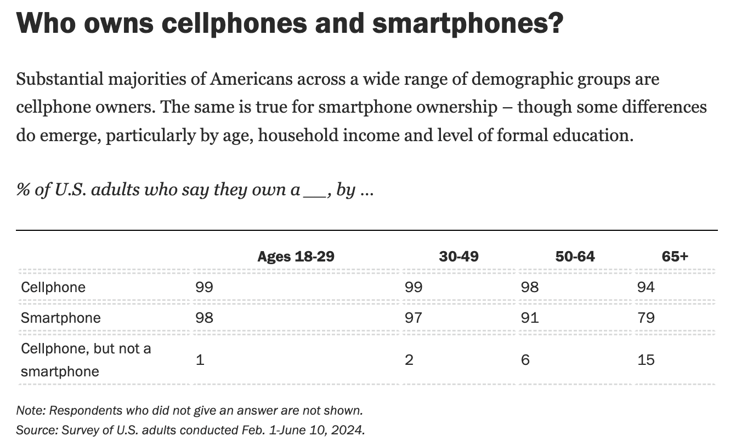

Slide 45

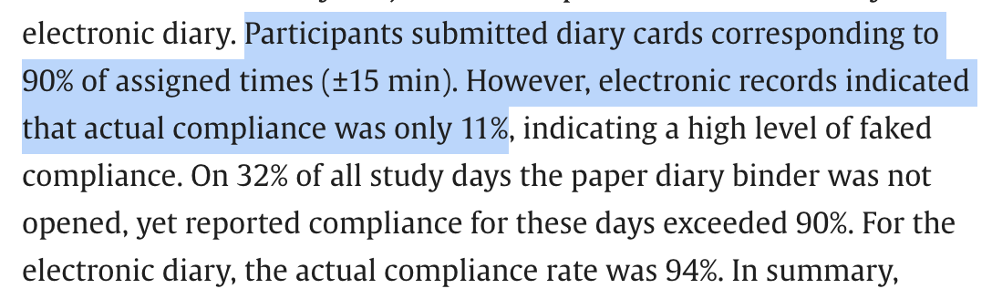

Slide 46
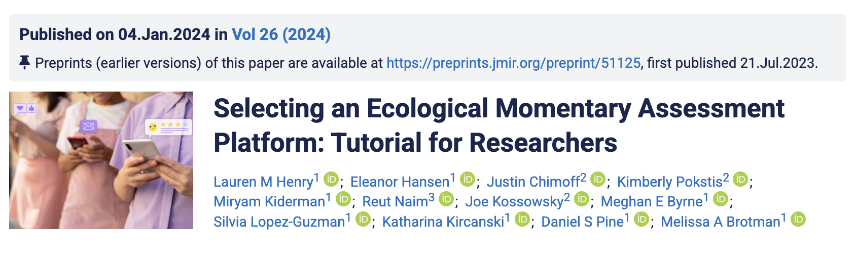
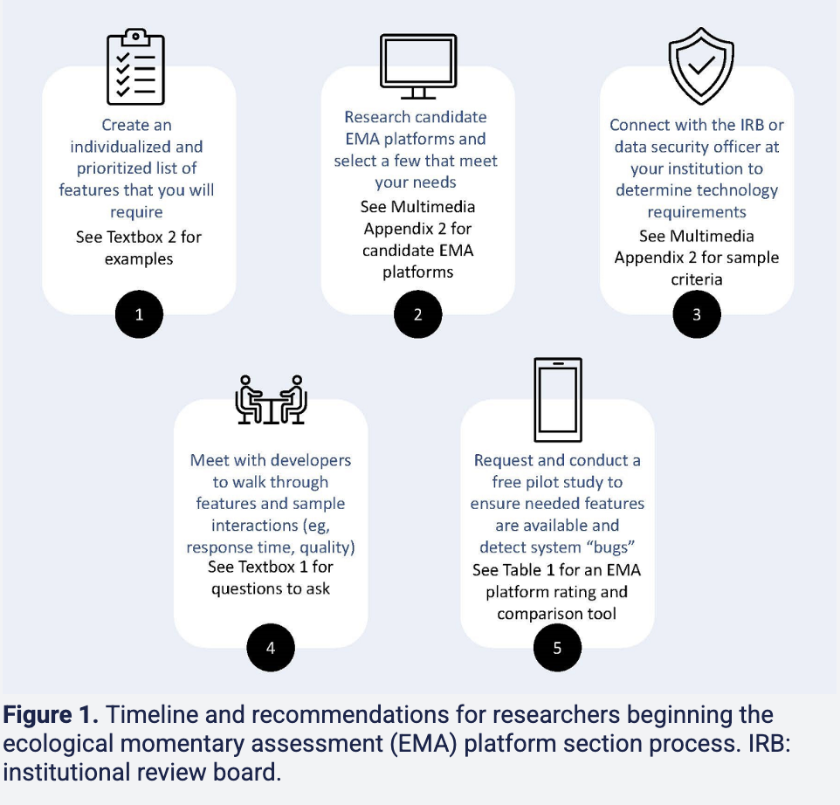
https://www.jmir.org/2024/1/e51125/

Slide 47
What technology/software should I use?
Electronic > paper
Preferable to use participants’ own phones, but make sure to choose a software that is flexible (e.g., iPhone, Android, texting option, iPad option)
Choose a software that meets your needs and your budget
Talk to developers and people who have used the software
Engage with your IRB/others at your institution who have used EMA/AA

Slide 48
In summary…
EMA compliance tends to be quite high, and study design has little impact
Focus on designing a solid study
What are your hypotheses?
What’s your modeling approach?
How much data do you need?
What is your plan for handling missing data?
Be transparent about your decisions and findings
If you will remove individuals based on low compliance, set that a-priori

Slide 49
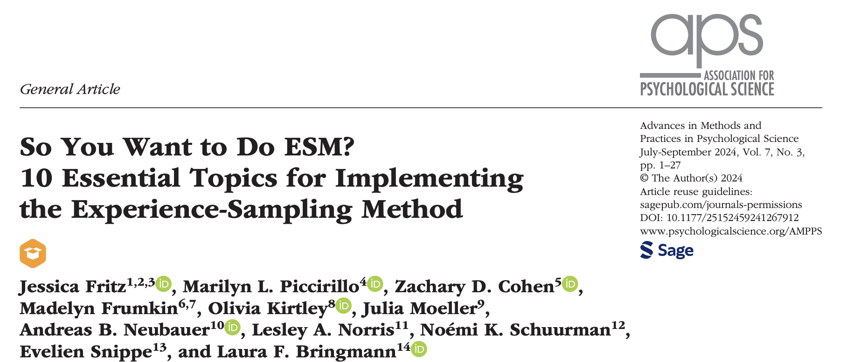

Slide 50
Questions?
Email: madelyn.r.frumkin@dartmouth.edu
Lab website: https://sites.dartmouth.edu/frumkin-lab/

Slide 52
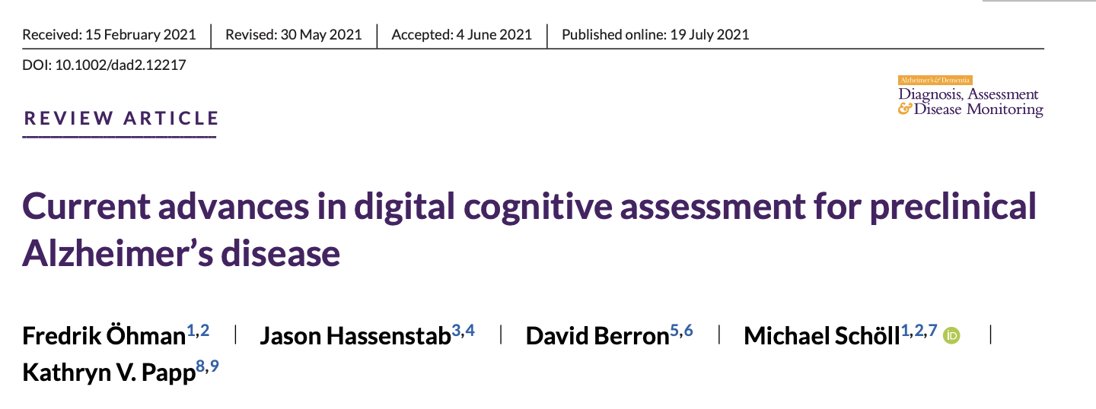
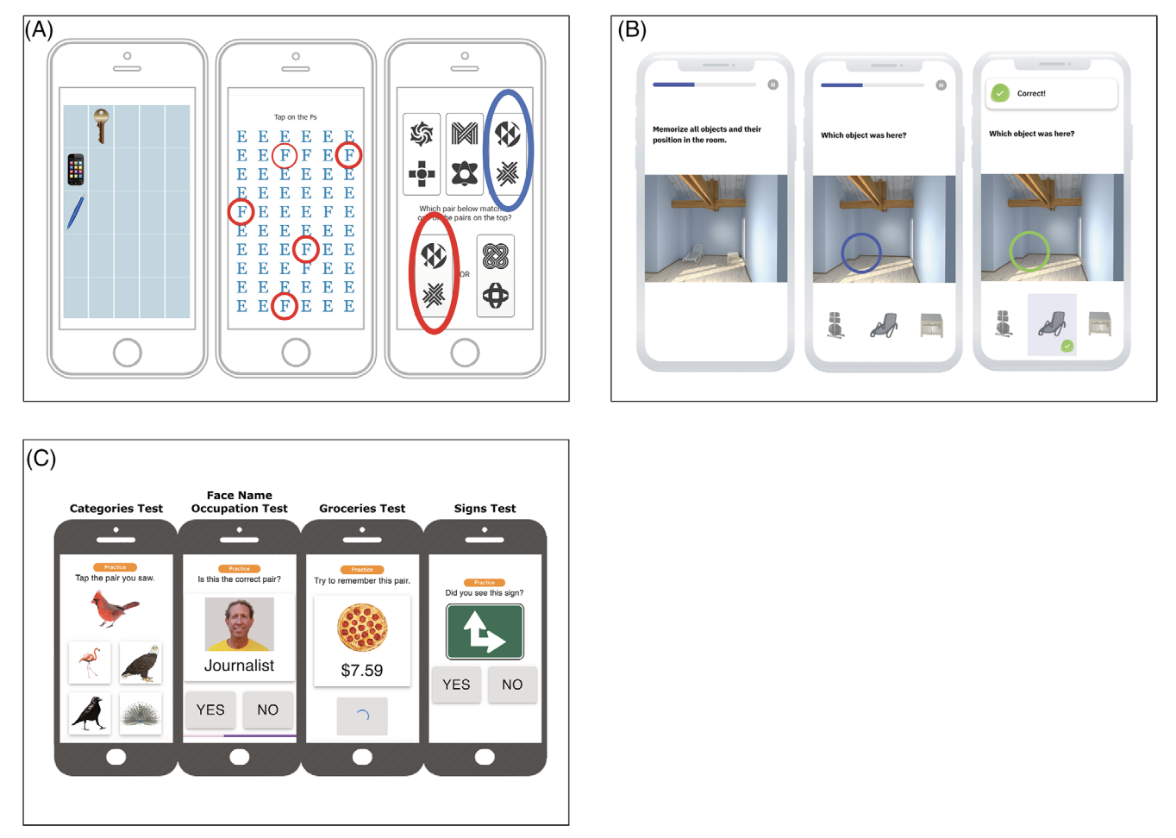
https://www.manybrains.net/

